Slide 1
ROS2 Jazzy CI/CD Pipeline Demo
Implementation of End-to-End Cloud Native DevOps for Robotics Applications
Project Github Link : Akankshakumbhare/ros2-jazzy-demo: ros2-jazzy-demo-application
Submitted by :
Akanksha Kumbhare
Kumbhare.akanksha12@gmail.com
Date : 21st May 2026

Slide 2
Project Overview
Enterprise-grade CI/CD pipeline for ROS2 Jazzy.
Automated infrastructure provisioning.
Docker-based deployment workflow.
Kubernetes orchestration using AKS.
Monitoring and security integration

Slide 3
Technologies Used
ROS2 Jazzy
Azure DevOps
Docker
AKS
ACR
Terraform
Helm
NGINX Ingress
Prometheus
Grafana

Slide 4
Infrastructure Provisioning
Terraform provisions:
Resource Group
AKS Cluster
Azure Container Registry
Log Analytics Workspace
NGINX Ingress
Cert-manager

Slide 5
Docker Containerization
ROS2 Jazzy base image
ROS2 publisher/subscriber packages installed
Health checks implemented
Secure non-root user execution

Slide 6
Azure DevOps CI/CD Pipeline
Stage 1: Build & Security Scan
Stage 2: Runtime Validation
Stage 3: Deploy to AKS
Stage 4: Automatic Rollback

Slide 7
Security with Trivy
Vulnerability scanning
Critical severity blocking
JSON report generation
Artifact publishing

Slide 8
Kubernetes Deployment
Resources Used:
Namespace
Deployment
Service
Ingress
Benefits:
Self-healing
Scalability
High availability

Slide 9
NGINX Ingress & TLS
External traffic routing
TLS termination
Automatic HTTPS certificates using cert-manager
Secure communication

Slide 10
Monitoring & Observability
Monitoring Stack:
Prometheus
Grafana
Kubernetes Logs
AKS Metrics
Dashboards:
CPU, Memory, Network, Pod Health

Slide 11
Production Features
Terraform IaC
Automatic Rollback
Runtime Validation
TLS Automation
Workload Identity
Centralized Logging

Slide 12
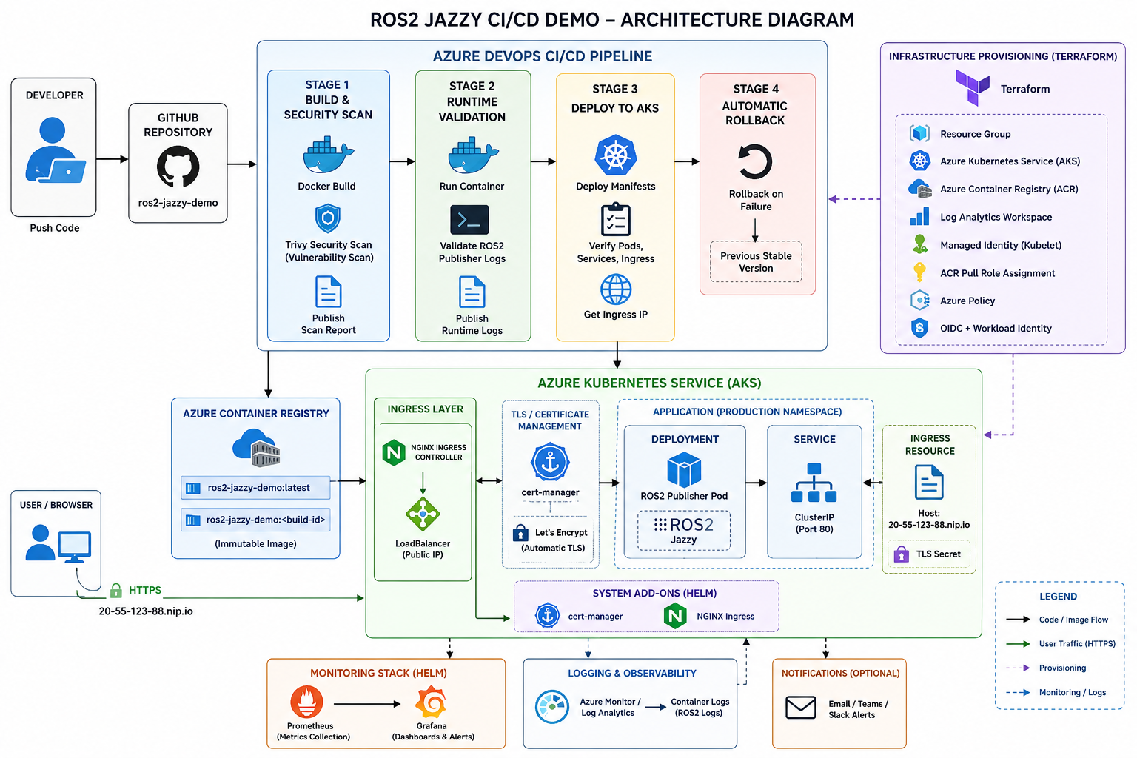
Architecture Diagram

Slide 13
Challenges Faced
Azure service connection setup
Kubernetes ingress configuration
ACR authentication issues
Terraform role assignments
CI/CD pipeline debugging

Slide 14
Future Improvements
ArgoCD GitOps
HPA Autoscaling
SonarQube Integration
Blue-Green Deployment
Multi-stage Docker builds

Slide 15
Project Limitation
Ingress and Service are included to demonstrate Kubernetes networking and TLS integration, although the ROS2 publisher itself is not an HTTP-based workload."

Slide 16
Conclusion
This project demonstrates a complete enterprise-grade DevOps workflow for ROS2 applications using Azure, Kubernetes, Docker, Terraform, and monitoring tools.

Slide 17
Thank YoU

